Slide 1
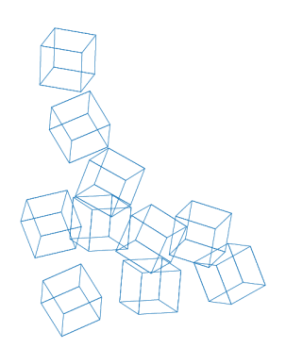
The Strength of the Group
since 80 years we’ve been constructing the World
all over the world, every day, construction sites can rely on Mapei
January 2018

Slide 2
The Strength of the Group
Mapei today
Day in day out, construction sites all around the world can rely on Mapei.
More than 80 years with constant aim of supplying solution of excellence.
Mapei’s leadership is based on their unrivalled know-how.
2.8 billion euros of presumed consolidated turnover in 2019

Slide 3
The Strength of the Group
Research & Development
31 R&D labs all over the world for a high speed market in the building world.
A considerable portion of Mapei’s annual turnover is channeled into investments
for research & Development.
Research and innovation are the cornerstones and real driving force behind
our growth.

Slide 4
The Strength of the Group
Production
More than 25.000 tons of products shipped every day.
Our production system is powerful, efficient, flexible and sustainable.
83 production plants worldwide to guarantee efficiency and to satisfy
our customer needs

Slide 5
The Strength of the Group
Products
With more than 66.000 customers , we supply a huge range of products.
We have more than 5.500 such as sealants, adhesives, admixtures, special mortars.
20 Product Lines that can offer solutions with no equal for every kind of construction
site, from major projects to private houses.

Slide 6
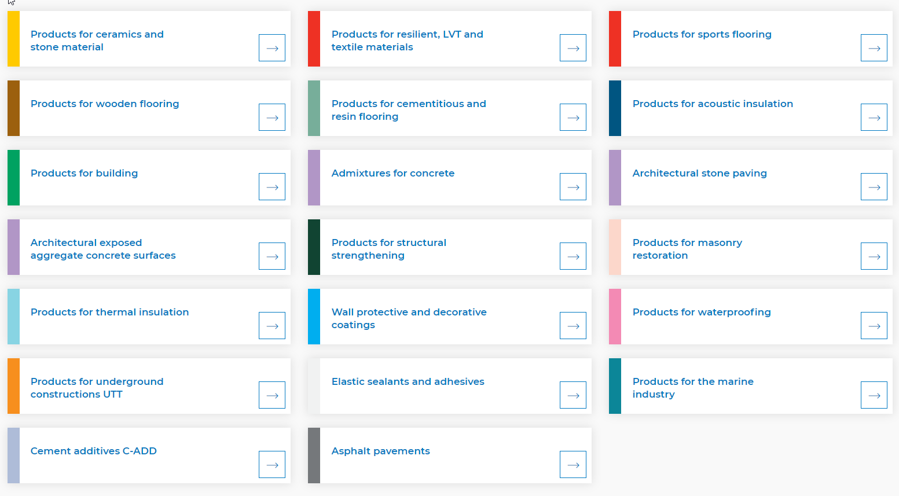
The Strength of the Group
Our product Lines

Slide 7
The Strength of the Group
Counselling and technical services
More than 1.000 new formulates every year to get durable results and
to satisfy the needs of designers, architecs, dealers and end users.

Slide 8
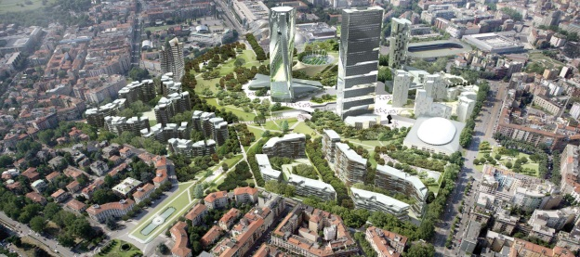
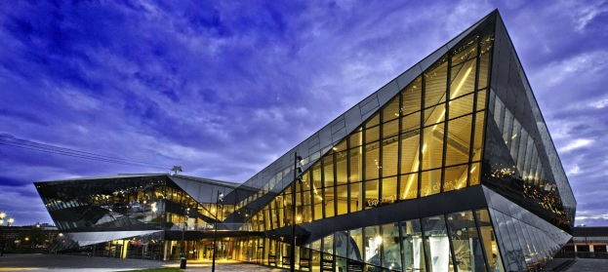
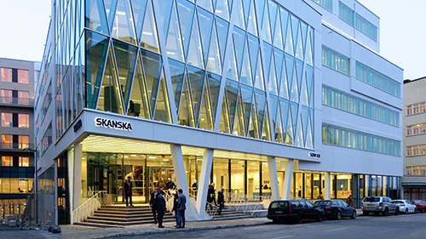
The Strength of the Group
Sustainability
More than 50.000 tons di CO₂ offset. Experience, research and innovation
to build a sustainable future together.
Our worldwide references are the best proof that show our solutions are
durable and sustainable keeping innovative and technologycal features.
Mapletree - Singapore
CityLife - Italy
Siemens - UK
Marina Bay - Singapore
Skansea HQ - Norway
Porta Nuova - Italy

Slide 9
The Strength of the Group
Training
More than 161.000 professionals from the sector involved. We implement
the best training methods and the results prove us right.
Through Mapei Academy we promote refresher courses and installation
workshops to perfect the application techniques for our products.

Slide 10
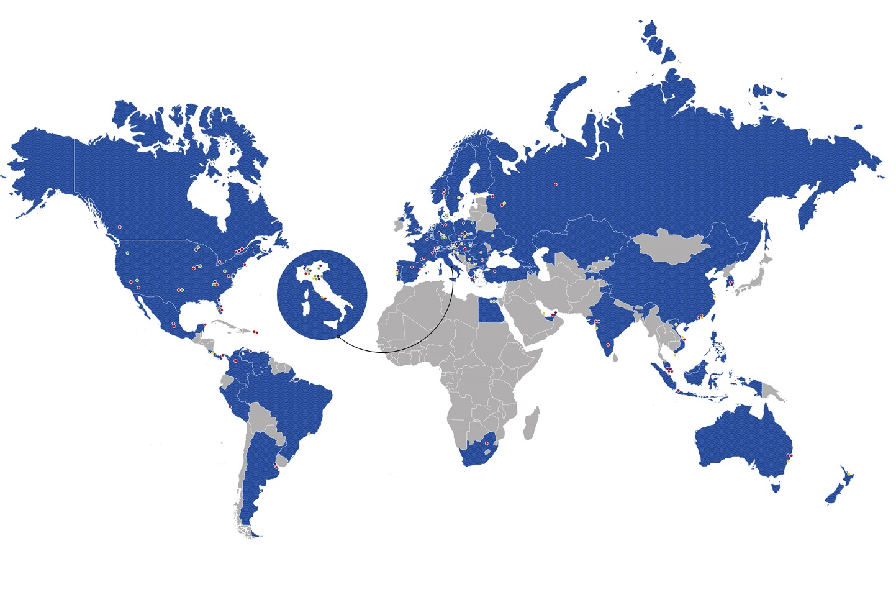
The Strength of the Group
The World of Mapei
83 Plants
in 5 continents
in 36 countries
90 Subsidiaries
in 5 continents
in 57 countries

Slide 11
Thank you
for your attention
www.mapei.com

